Slide 1
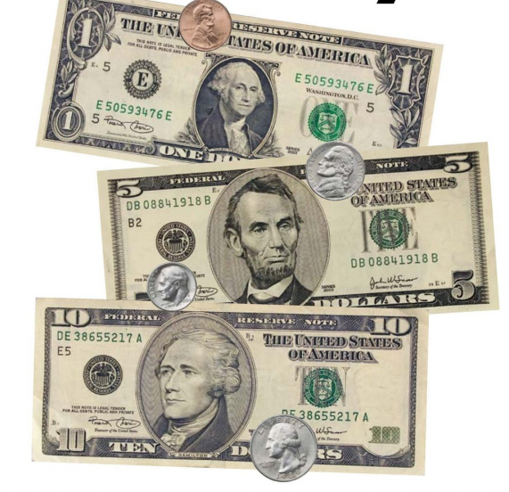
I Save Money

Slide 2
Click to see you saved how much money?
penny
nickel
dime
dollar
dollars
money

Slide 3
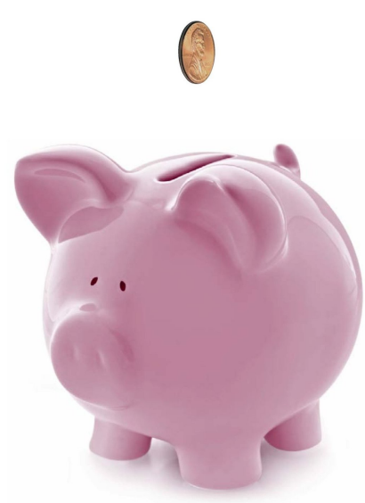
I save a penny.
return

Slide 4
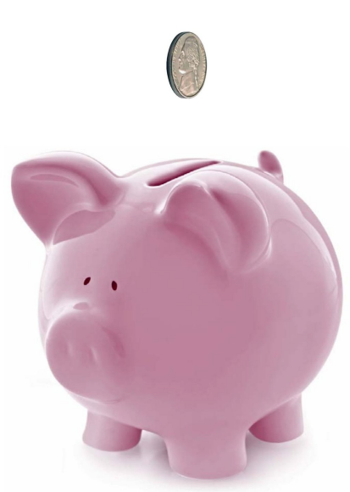
I save a nickel.
return

Slide 5
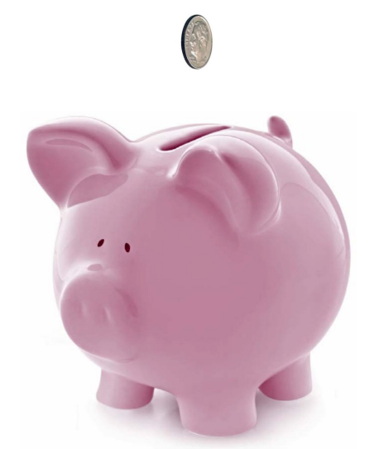
I save a dime.
return

Slide 6
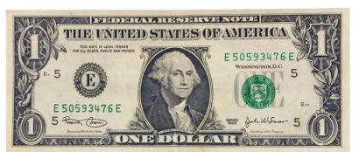
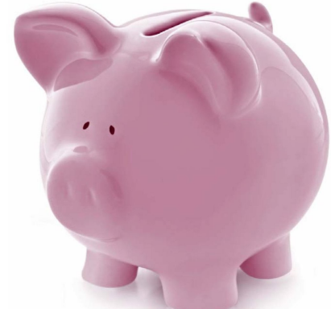
I save a dollar.
return

Slide 7
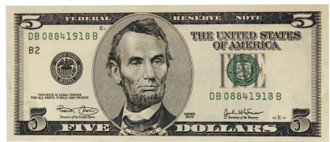
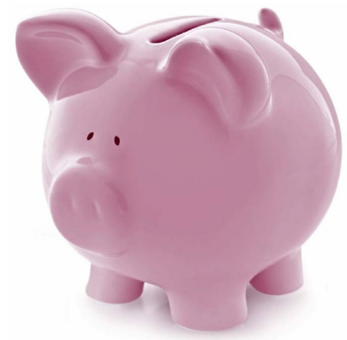
Isave five dollars.
return

Slide 8
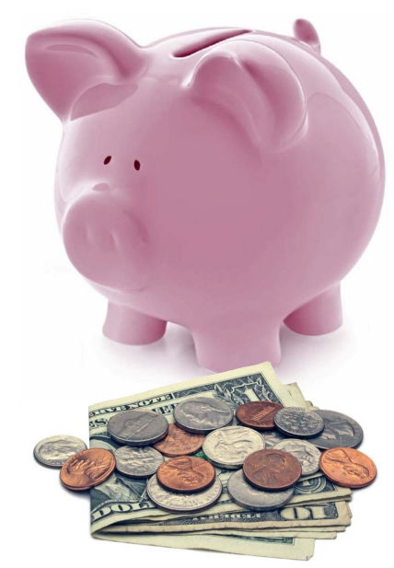
I save money.
return

